Slide 1

ANALYSIS OF RAINFALL prediction ESSENTIALS of data analytics project
V.Sai preetham 19bce1434
B.KARTHIK 19BCE1446
M SAI NITHIN 19BCE1164
D.ANIRUDH 19BCE1030

Slide 2
CONTENTS:-
INTRODUCTION
PROBLEM STATEMENT
OBJECTIVE
FLOW OF WORK
DATASET
DATA CLEANING AND PREPARATION
STATISTICAL MEASURES
GRAPHS AND VISUALIZATIONS
RESULTS OF MODELS
COMPARISON OF MODELS
CONCLUSION

Slide 3
INTRODUCTION
Rainfall is the most crucial process of nature. All the living being rely on water and rainfall is a process that is responsible for the continual process of water cycle. Many farmers will depend upon the rainfall for cultivating many essential crops for us, government also looking ahead of prediction of rainfall which will be useful for the future purposes, many human activities like agriculture are dependent on rainfall, especially in a country like India. Thus, it is very important and necessary to predict the rainfall patterns to estimate the flooding and drowning events, Hence we need to analyze the rainfall data to have such pattern and in this we have to describe about the rainfall ,diagnosis the rainfall patterns and also predict the rainfall using the analytics of the rainfall patterns, To predict the rainfall Application of algorithms is the best way to forecast rainfall. These algorithms predict rainfall numerically. There are two kinds of approaches for it. They are empirical and dynamic methods. Empirical approach consists of evaluating historical data, identifying the pattern or relationship between the given atmospheric variables that determine rainfall

Slide 4
PROBLEM STATEMENT
Farmers have no idea of falling rains in order to cultivate the crops and they cannot predict when the rainfall will occur .To solve this problem we will collect the data(information),datasets and will predict the rainfall percentage which will be useful to the farmers.
It is also important to understand the rainfall patterns across different years in the different states in order to predict the rainfall at that particular location

Slide 5
OBJECTIVES
Objective is to need to analyze the rainfall data to have such pattern and in this we have to describe about the rainfall ,diagnosis the rainfall patterns and also predict the rainfall using the analytics of the rainfall patterns, and will visualize the graphs and have the patterns using visualizing tools, To predict the rainfall Application of algorithms is the best way to forecast rainfall. These algorithms predict rainfall numerically. There are two kinds of approaches for it. They are empirical and dynamic methods. Empirical approach consists of evaluating historical data, identifying the pattern or relationship between the given atmospheric variables that determine rainfall. It includes many kinds of clustering and classification techniques and also the implementation of the rainfall prediction is very crucial in these days for the farmers and government hence there are many methods and many algorithms which will be very useful for the predicting the rainfall in these days, Dynamic approach consists of dynamically changing training samples whose results can be applied to other large samples of data. In this rainfall prediction by using the machine learning algorithms how rainfall fall can be predicted by machine learning algorithms good accuracy and also using the machine learning algorithms it will be very good for the finding of the rainfall prediction of the machine learning algorithms of dynamic approach like linear regression algorithms, SVM machine learning algorithm and will build UI website for the rainfall prediction

Slide 6
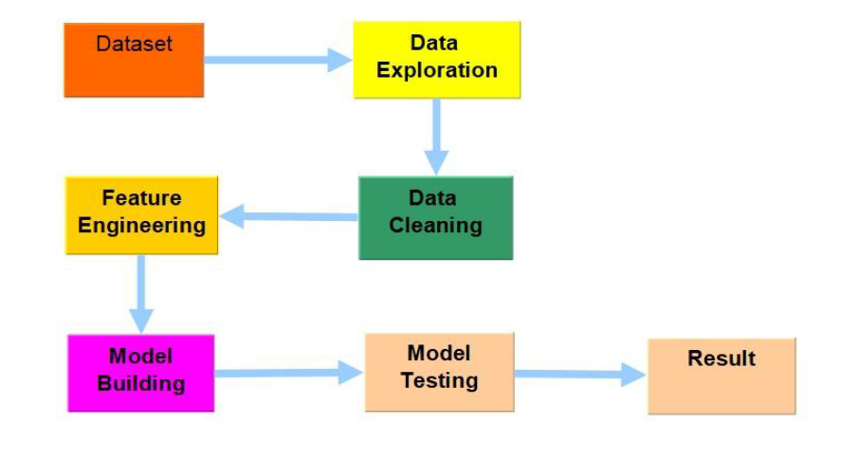
FLOW OF WORK

Slide 7
DATA DESCRIPTION AND PREPARATION
Our dataset consists of 23 columns and 145460 rows in total. $ Date: char $ Location: char $ MinTemp : num $ MaxTemp : num $ Rainfall: num $ Evaporation: num $ Sunshine: num $ WindGustDir : char $ WindGustSpeed: int $ WindDir9am: char $ WindDir3pm: char $ WindSpeed9am: int $ WindSpeed3pm: int $ Humidity9am: int $ Humidity3pm: int $ Pressure9am: num $ Pressure3pm: num $ Cloud9am: int $ Cloud3pm: int $ Temp9am: num $ Temp3pm: num $ RainToday : char $Rain tomorrow: char
In the Data Exploration phase dealing with the weather of the Australian data which helps to analyze and predict the rainfall patterns and which consists of columns like date, Location, MinTemp, MaxTemp, Rainfall, Evaporation, Sunshine, Wind Speed, Wind direction at different times, Cloud at different times, Humidity at different times, pressure at different times, Temperature at different times, Rain today, Rain tomorrow. These are the variables included in the dataset which will be useful for the Analyzing the rainfall patterns and analyzing the prediction of rainfall

Slide 8
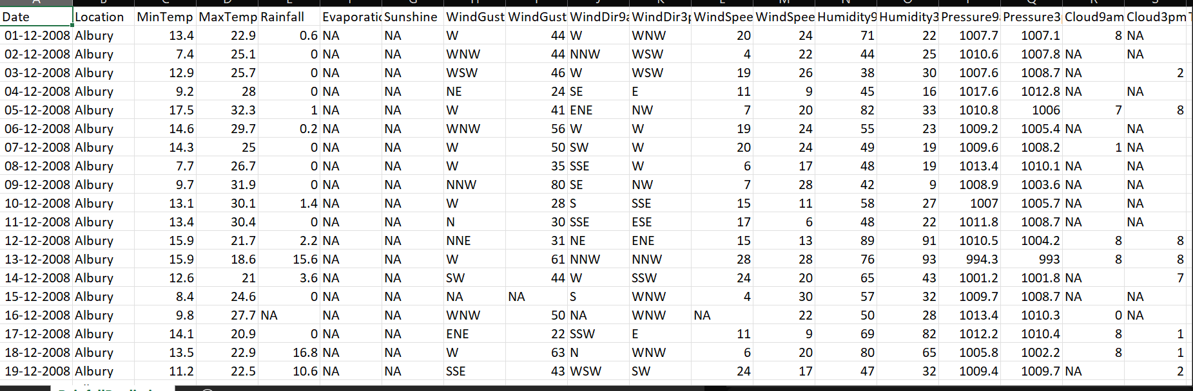
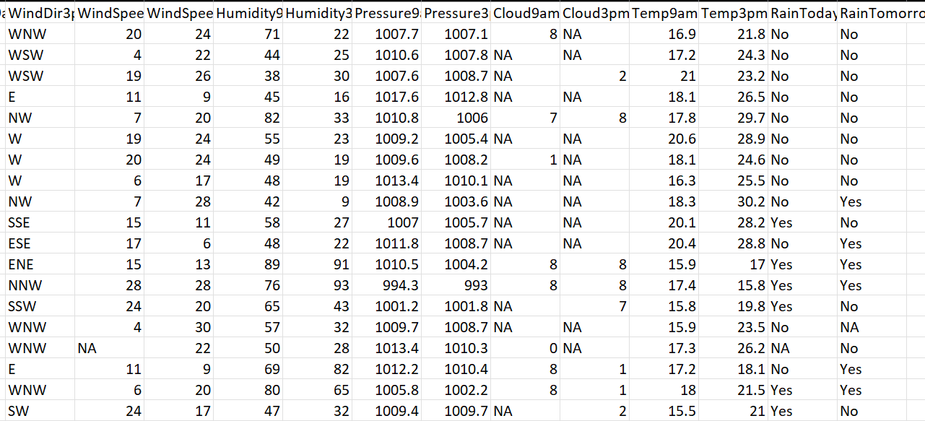
DATASET

Slide 9
DATA CLEANING AND PREPARATION
The Data Cleaning is done in the four phases in accordance to the type of the variables present in the dataset.
Hence it divided into 4 parts
1. Categorical
2. Discrete
3. Numerical
4. Continuous
For the Discrete Data we had Imputed values by the method of Mode Imputation technique. For the categorical data imputed by the mean Imputation technique and for numeric values the median imputation has been imputed into the missing NA values and for the empty columns the Random Imputation technique has been done to get some relation between the Sunshine, Evaporation and the rainfall and for the windspeed direction has divided the directions based on the indexes of the numbers and made the count of the vales to the indexes and imputed with the following count of the wind speed direction and for the Rain tomorrow and rain today the imputation has done by proceeding with yes quantities to the variables. In the R-code the KNN technique and median technique is used for the accurate values of the missing value

Slide 10
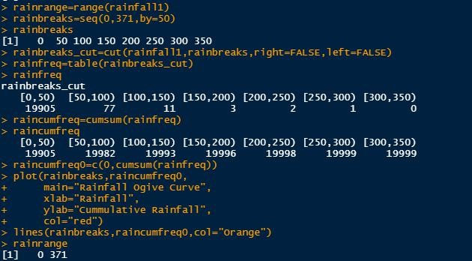
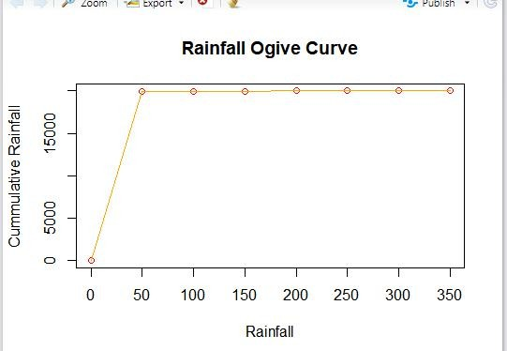
STATISTICAL MEASURES

Slide 11
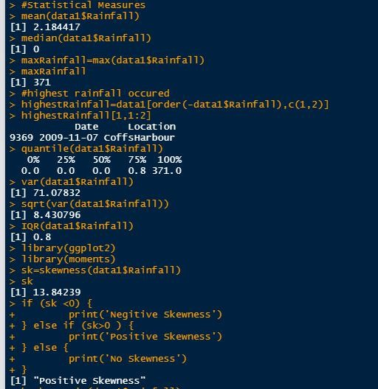
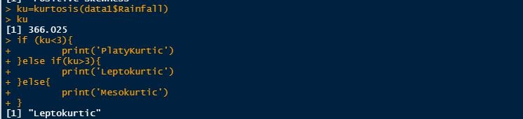
STATISTICAL MEASURES
The Kurtosis is found to be 366.02 which is extremely high belongs to the Leptokurtic range
The Data is found to be positive Skewness data and the IQR is found to be 0.8 and the place in which maximum rainfall occurred is Cardsharper which is on the date of 07-11-2009

Slide 12
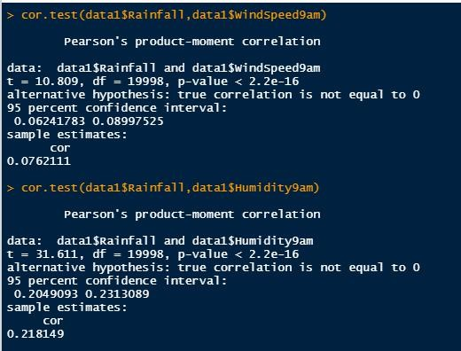
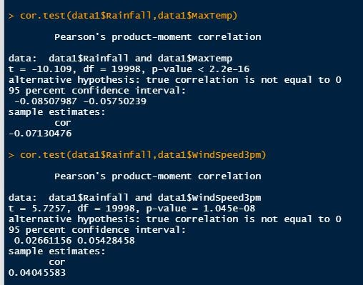
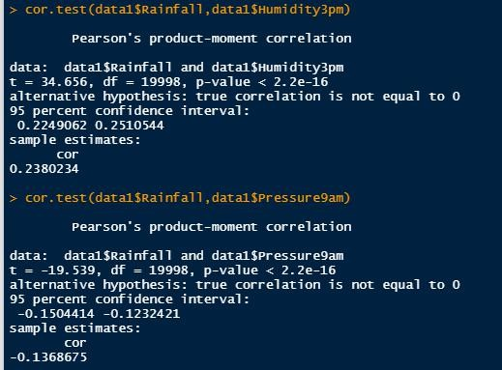
CORRELATION

Slide 13
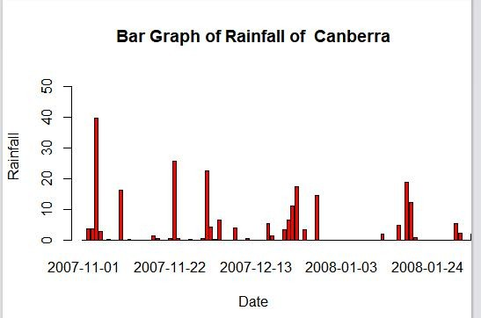
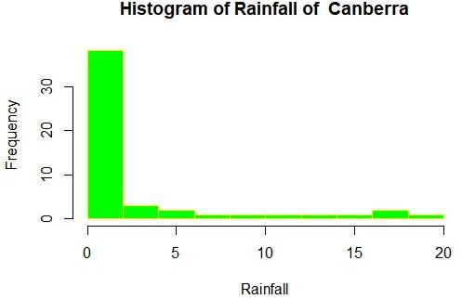
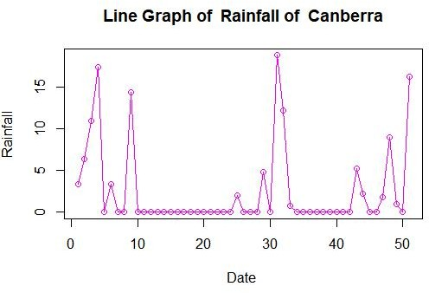
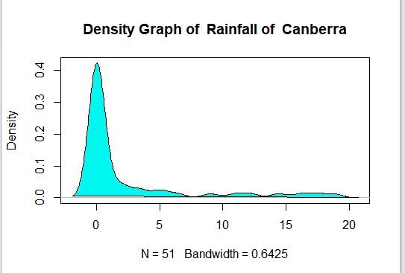
GRAPHS AND VISUALIZATIONS

Slide 14
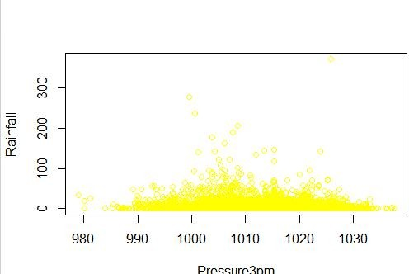
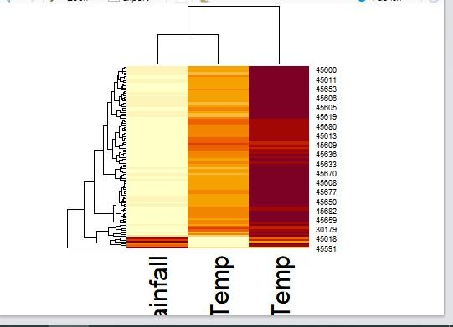
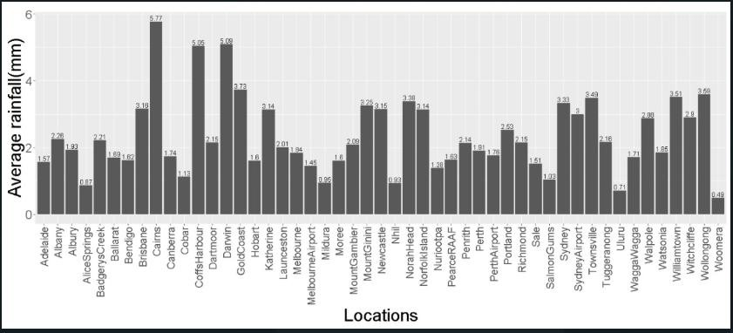
GRAPHS AND VISUALIZATIONS

Slide 15
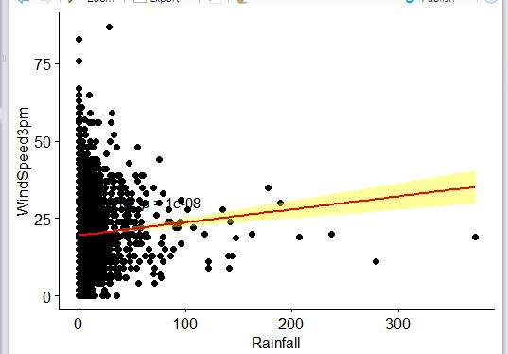
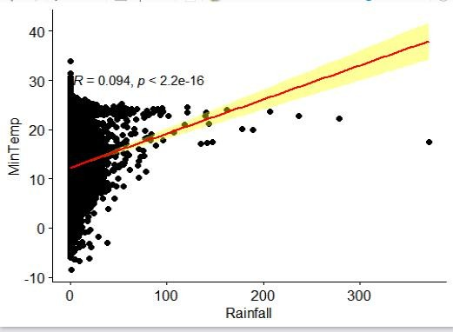
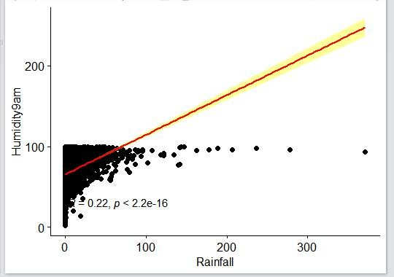
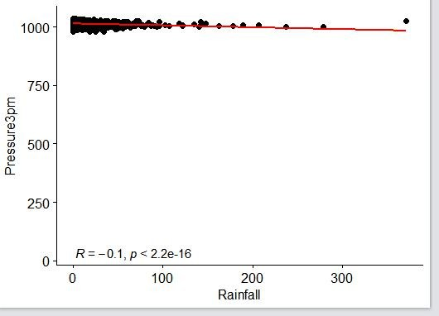
RESULTS OF MODELS
1. LINEAR REGRESSION MODEL:-

Slide 16
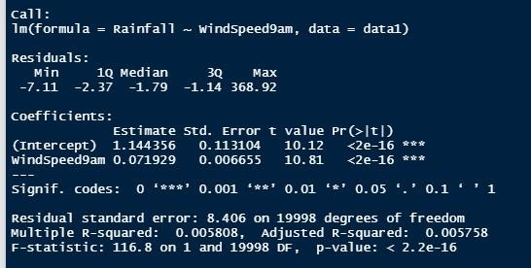
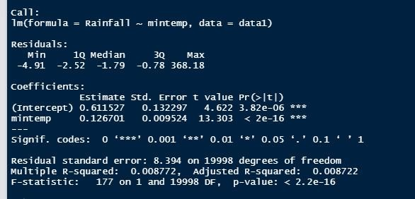
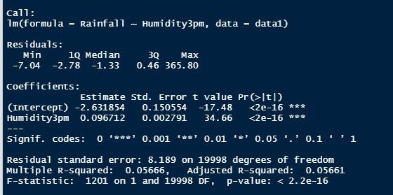
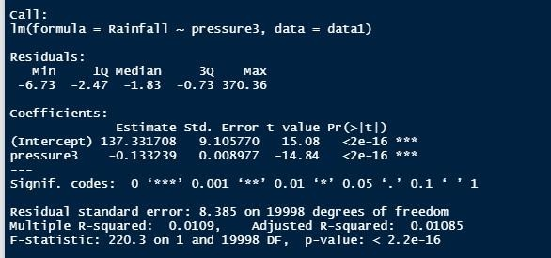
LINEAR REGRESSION MODEL:-

Slide 17
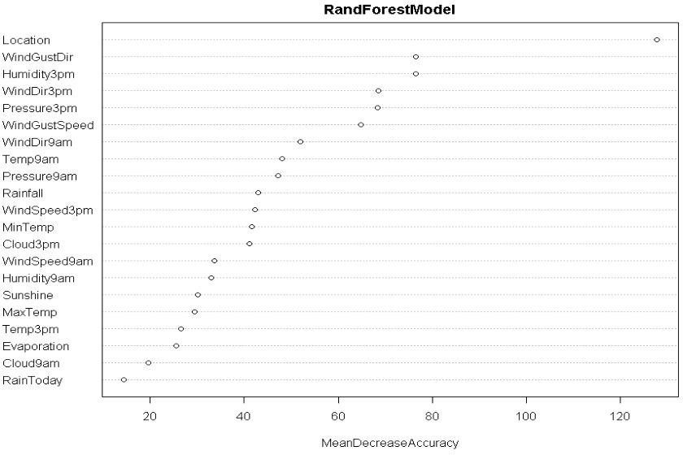
RANDOM FOREST MODEL
Mean Decreasing accuracy was found for the dataset in order to know which factor or which variable will fit for the classification or the Random Forest by the way WindGust direction fits more for the random forest because windGustDir has the most of the rain depends upon the wind gust dir random forest probably selects with highest mean decrease accuracy Value

Slide 18
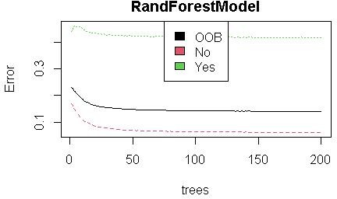
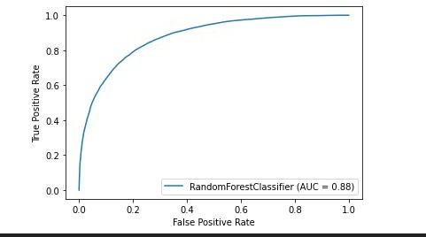
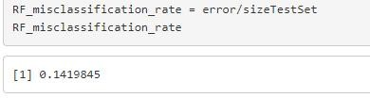
RANDOM FOREST MODEL

Slide 19
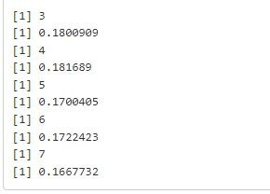
KNN MODEL
In this Model we chose 7 neighbors and calculated the misclassification
For the 3 nearest neighbors we got the misclassification rate of 0.18
For the 4 nearest neighbors we got the misclassification rate of 0.181
For the 5 nearest neighbors we got the misclassification rate of 0.17
For the 6 nearest neighbors we got the misclassification rate of 0.172
For the 7 nearest neighbors we got the misclassification rate of 0.166
So we can say that if we take the more neighbours the misclassification rate of the rainfall will be reduced in this case we got the 7 neighbours as least misclassification rate

Slide 20
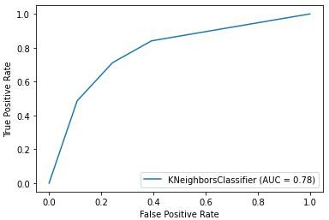
KNN MODEL

Slide 21
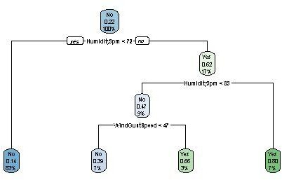
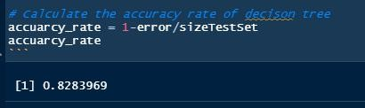
DECISION TREE
Accuracy of 82 percentage
In Decision Tree
As Humidity is highly correlated with the Rainfall so the humidity has more entropy which makes it retained at the root node and followed by the WindGustSpeed ,etc

Slide 22
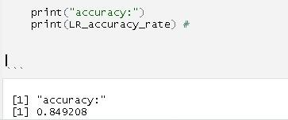
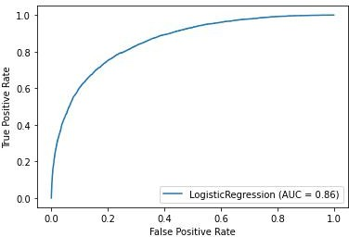
Logistic REGRESSION
There are multiple columns that are binary they are rainfall tomorrow and rainfall today columns they decide the logistic regression be fit the model or not since they are only Yes or No terms 1 and 0 have been made to classify for logistic regression and got the accuracy of 84.9 percentage

Slide 23
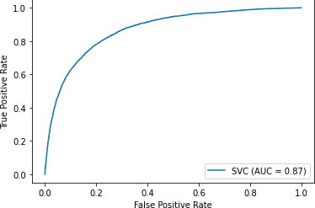
SVM MODEL

Slide 24
COMPARISION OF MODELS
RANDOM FOREST | Precision | Recall | F1-Score | Support
0 | 0.90 | 0.76 | 0.82 | 22717
1 | 0.45 | 0.71 | 0.55 | 6375
Accuracy | - |  | 0.75 | 29092
Macro avg | 0.68 | 0.73 | 0.69 | 29092
Weighted avg | 0.80 | 0.75 | 0.76 | 29092
LOGISTIC REGRESSION | Precision | Recall | F1-Score | Support
0 | 0.92 | 0.79 | 0.85 | 22717
1 | 0.50 | 0.76 | 0.61 | 6375
Accuracy | - |  | 0.78 | 29092
Macro avg | 0.71 | 0.77 | 0.73 | 29092
Weighted avg | 0.83 | 0.78 | 0.80 | 29092
KNN MODEL | Precision | Recall | F1-Score | Support
0 | 0.90 | 0.91 | 0.90 | 22717
1 | 0.65 | 0.62 | 0.64 | 6375
Accuracy | - |  | 0.84 | 29092
Macro avg | 0.77 | 0.76 | 0.77 | 29092
Weighted avg | 0.84 | 0.84 | 0.84 | 29092
SVM MODEL | Precision | Recall | F1-Score | Support
0 | 0.92 | 0.87 | 0.87 | 22717
1 | 0.54 | 0.67 | 0.63 | 6375
Accuracy | - |  | 0.81 | 29092
Macro avg | 0.73 | 0.79 | 0.75 | 29092
Weighted avg | 0.84 | 0.81 | 0.82 | 29092

Slide 25
CONCLUSION
The estimation of rainfall is important in terms of resource management and farming. It can be met with an incorrect or incomplete estimation as rainfall changes from region to region. In this paper, the weather Australia dataset is taken where it features fields like humidity, temperature, pressure, sunlight, and evaporation. Five machine learning models have been developed: linear regression, logistic regression, random forest, and KNN. The models are trained with 80% of the data and the rest of the data is used for testing, amongst the five models Random Forest and logistic regression 83 and 85% respectively, because of the non-linear relation between the fields linear regression had very less accuracy. The daily wise data set makes the model more reliable and accurate

Slide 26
THANK YOU

